Slide 1
Chapter 1
Introduction
1.<number>

Slide 2
Chapter 1: Outline
1.1 Data Communications
1.2 Networks
1.3 Network Types
Notes:
1.#

Slide 3

Chapter 1: Objective
The first section introduces data communications and defines their components and the types of data exchanged. It also shows how different types of data are represented and how data is flowed through the network.
The second section introduces networks and defines their criteria and structures. It introduces four different network topologies that are encountered throughout the book.
The third section discusses different types of networks: LANs, WANs, and internetworks (internets). It also introduces the Internet, the largest internet in the world. The concept of switching is also introduced in this section to show how small networks can be combined to create larger ones.
Notes:
1.#

Slide 4
    1-1 DATA COMMUNICATIONS
When we communicate, we are sharing information. This sharing can be local or remote. The term telecommunication, which includes telephony, telegraph, and television, means communication at a distance.
Data communications are the exchange of data between two devices via some form of transmission media.
1.<number>
Notes:
1.#

Slide 5
Data Communication: The effectiveness of a data communication system depends on three fundamental characteristics
Delivery: The system must deliver data to the correct destination,
Accuracy: The system must deliver data correctly,
Timeliness: The system must deliver data in a timely manner,
Jitter: Variation in packet arrival time. Uneven quality in the video or audio delivery.

Slide 6
1.1.1 Components
A data communications system has five components (see Figure 1.1).
1.<number>
Notes:
1.#

Slide 7
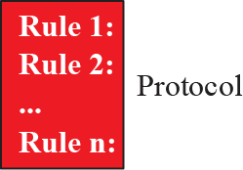
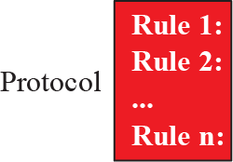
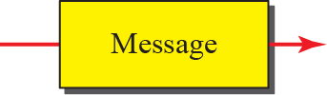


Figure 1.1: Five components of data communication
1.<number>
Notes:
1.#

Slide 8
1.1.2 Data Representation
Information today comes in different forms such as text, numbers, images, audio, and video.
1.<number>
Notes:
1.#

Slide 9
1.1.3 Data Flow
Communication between two devices can be simplex, half-duplex, or full-duplex as shown in Figure 1.2.
1.<number>
Notes:
1.#

Slide 10
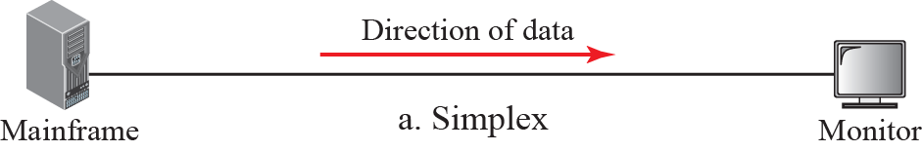
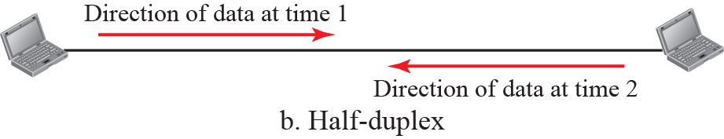
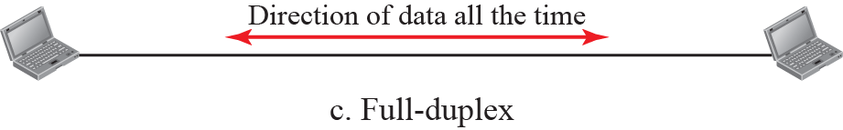
Figure 1.2: Data flow
1.<number>
Notes:
1.#

Slide 11
    1-2 NETWORKS
A network is the interconnection of a set of devices capable of communication. In this definition, a device can be a host such as a large computer, desktop, laptop, workstation, cellular phone, or security system. A device in this definition can also be a connecting device such as a router a switch, a modem that changes the form of data, and so on.
1.<number>
Notes:
1.#

Slide 12
1.2.1 Network Criteria
A network must be able to meet a certain number of criteria. The most important of these are performance, reliability, and security.
1.<number>
Notes:
1.#

Slide 13
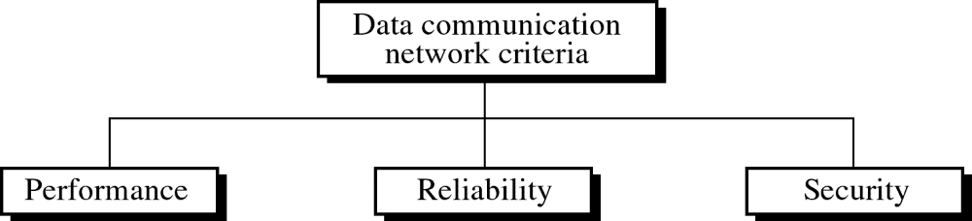
Networks: is a set of devices (often referred to as nodes) connected by media links.

Slide 14
Performance: can be measured in many ways, including transit time and response time.
Performance depends on:
Number of users,
Type of transmission medium,
Hardware,
Software.
Performance is evaluated by throughput and time delay.

Slide 15
Reliability of network includes accuracy of delivery.
Reliability of network is measured by:
Frequency of failure,
Recovery time of a network after failure,
Catastrophe.

Slide 16
Network security issues include
Protecting data from Unauthorized access,
Protecting data from Damage and development,
Implementing policies and procedures for recovery and data losses.

Slide 17
1.2.2 Physical Structures
Before discussing networks, we need to define some network attributes.
1.<number>
Notes:
1.#

Slide 18
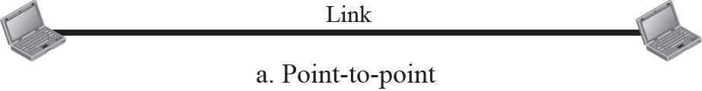
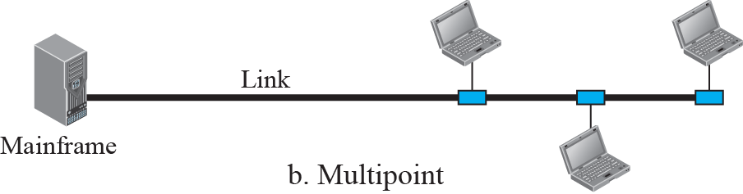
Figure 1.3: Types of connection
1.<number>
Notes:
1.#

Slide 19

Figure 1.x Categories of topology
1.<number>
Notes:
1.#

Slide 20
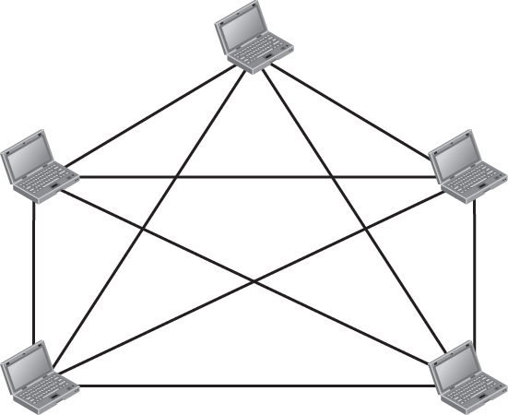


Figure 1.4: A fully-connected mesh topology
1.<number>
Notes:
1.#

Slide 21
Advantages:
Use of dedicated links guarantees that each link carry its own data load,
Robust, if one link becomes unusable, it does not incapacitate the entire system,
Privacy or security, only intended recipient see the message traveling along the dedicated link,
Easy fault identification and isolation.

Slide 22
Disadvantages:
Related to amount of cabling and number of I/O ports required,
Installation and reconfiguration are difficult,
Sheer bulk of the wiring can be greater than the available space,
Hardware required is expensive.
1.<number>

Slide 23

Note:
Mesh topology can be a backbone connecting the main computers of a hybrid network that can include several other topologies.

Slide 24
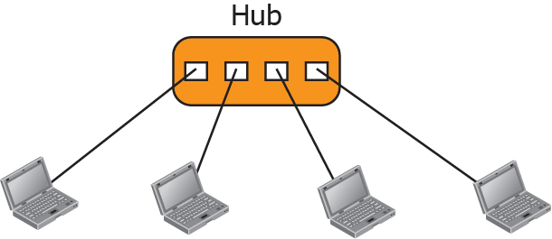
Figure 1.5: A star topology
1.<number>
Notes:
1.#

Slide 25
Advantages:
Less expensive than mesh,
Easy to install and reconfigure,
Robust, if one link fails, only that link is affected,
Easy fault identification and fault isolation.
Disadvantages:
If the hub goes down, the whole system is dead,
Cabling amount.

Slide 26
Note:
Star topology is used in LANs.

Slide 27
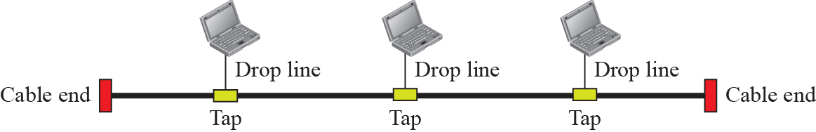
Figure 1.6: A bus topology
1.<number>
Notes:
1.#

Slide 28
Advantages:
Installation is easy,
Less cabling than mesh and star.
Disadvantages:
Reconfiguration and fault isolation are difficult.

Slide 29
Note:
Bus topology is used in LANs. Ethernet LANs can use a bus topology, but they are less popular now.

Slide 30
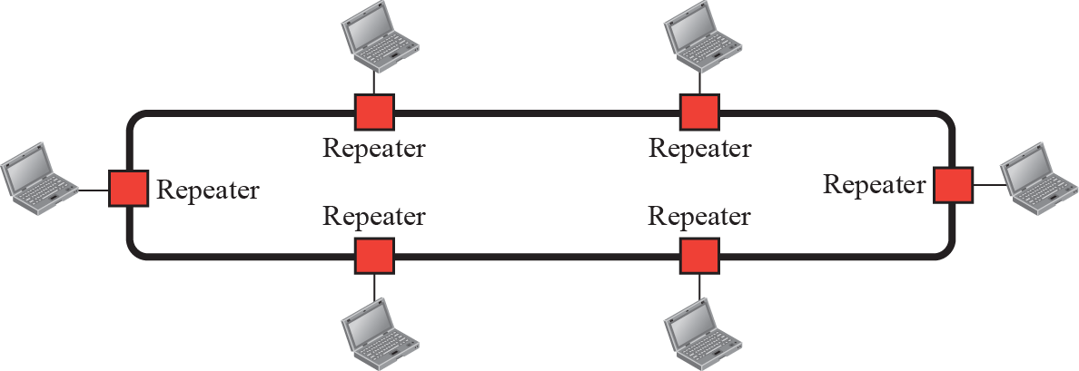
Figure 1.7: A ring topology
1.<number>
Notes:
1.#

Slide 31
Advantages:
Installation and reconfiguration are relatively easy,
fault isolation is simplified (alarm alert for signal lack),
Dual ring or switches are used to overcome ring break.

Slide 32
Disadvantages
Each packet of data must pass through all the computers between source and destination. This makes it slower than mesh and star topologies,
If one workstation or port goes down, the entire network gets affected,
Network is highly dependent on the wire which connects different components.
1.<number>

Slide 33
Note:
The only constraints are media and traffic considerations (maximum ring length and number of devices).

Slide 34
    1-3 NETWORKS TYPES
After defining networks in the previous section and discussing their physical structures, we need to discuss different types of networks we encounter in the world today. The criteria of distinguishing one type of network from another is difficult and sometimes confusing. We use a few criteria such as size, geographical coverage, and ownership to make this distinction.
1.<number>
Notes:
1.#

Slide 35
1.3.1 Local Area Network
A local area network (LAN) is usually privately owned and connects some hosts in a single office, building, or campus. Depending on the needs of an organization, a LAN can be as simple as two PCs and a printer in someone’s home office, or it can extend throughout a company and include audio and video devices. Each host in a LAN has an identifier, an address, that uniquely defines the host in the LAN. A packet sent by a host to another host carries both the source host’s and the destination host’s addresses.
1.<number>
Notes:
1.#

Slide 36
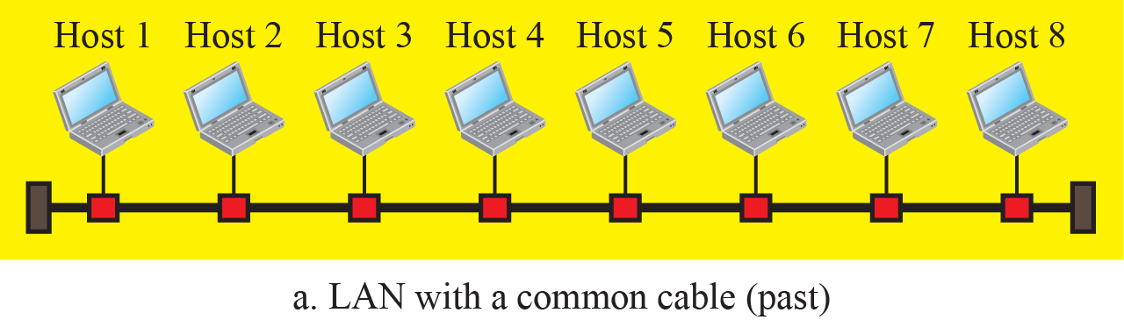
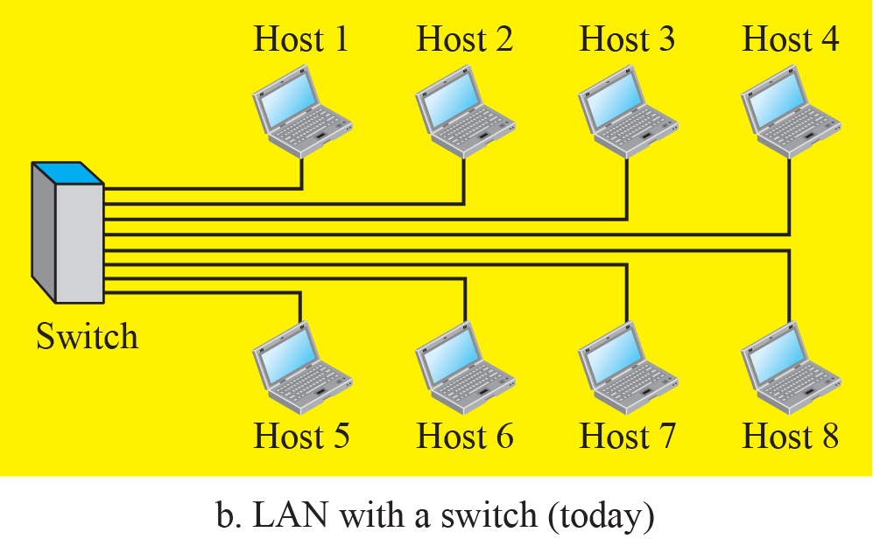
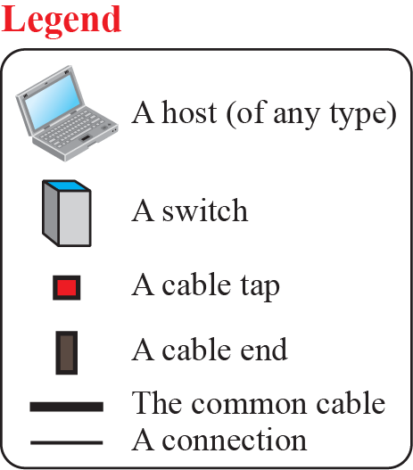
Figure 1.8: An Isolated LAN in the past and today
1.<number>
Notes:
1.#

Slide 37
1.3.2 Wide Area Network
A wide area network (WAN) is also a connection of devices capable of communication. However, there are some differences between a LAN and a WAN. A LAN is normally limited in size; a WAN has a wider geographical span, spanning a town, a state, a country, or even the world. A LAN interconnects hosts; a WAN interconnects connecting devices such as switches, routers, or modems. A LAN is normally privately owned by the organization that uses it; a WAN is normally created and run by communication companies and leased by an organization that uses it.
1.<number>
Notes:
1.#

Slide 38
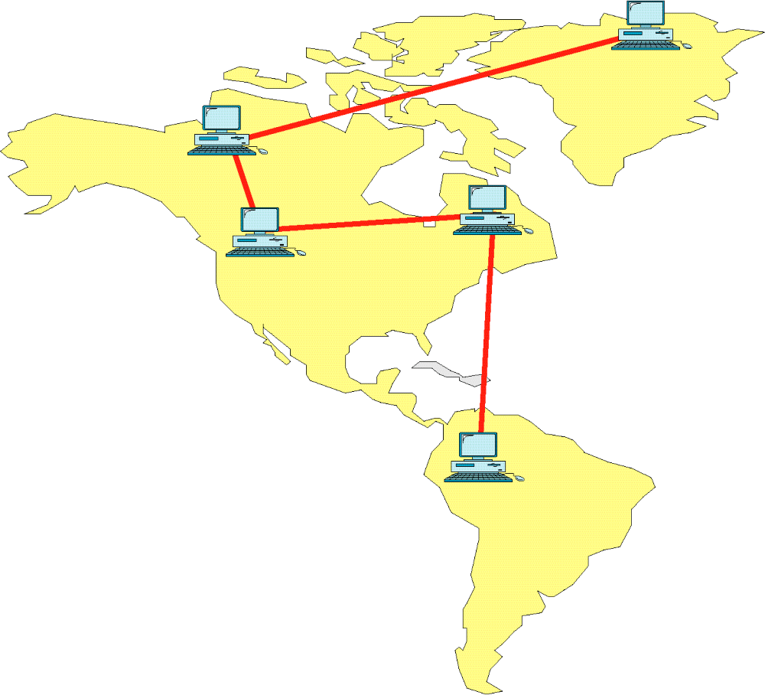
WAN/Internet

Slide 39
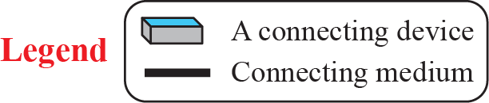
Figure 1.9: A Point-to-Point WAN
1.<number>
Notes:
1.#

Slide 40
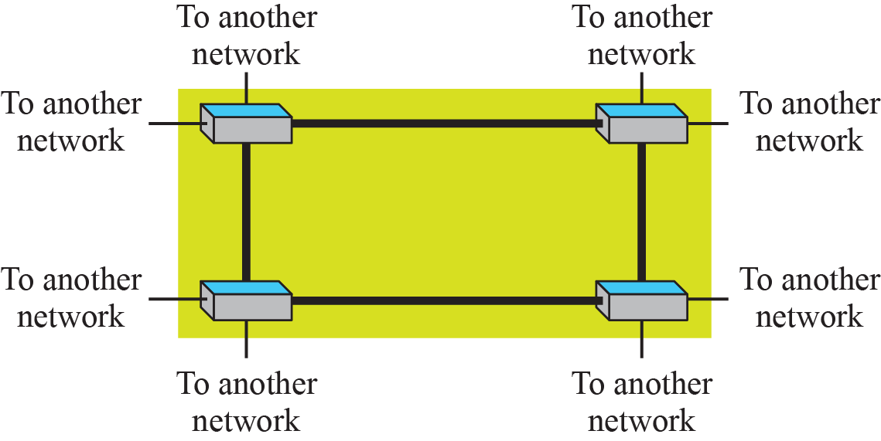
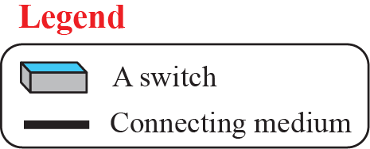
Figure 1.10: A Switched WAN
1.<number>
Notes:
1.#

Slide 41
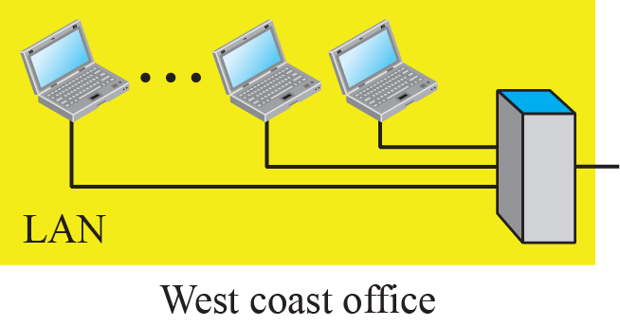
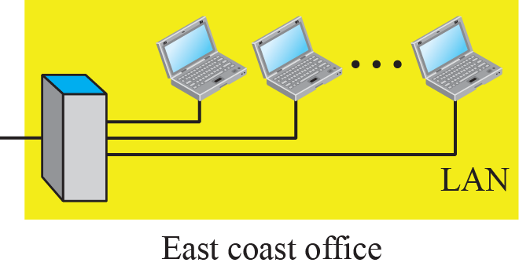
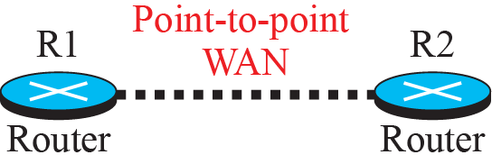
Figure 1.11: An internetwork made of two LANs and one WAN
1.<number>
Notes:
1.#

Slide 42

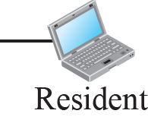
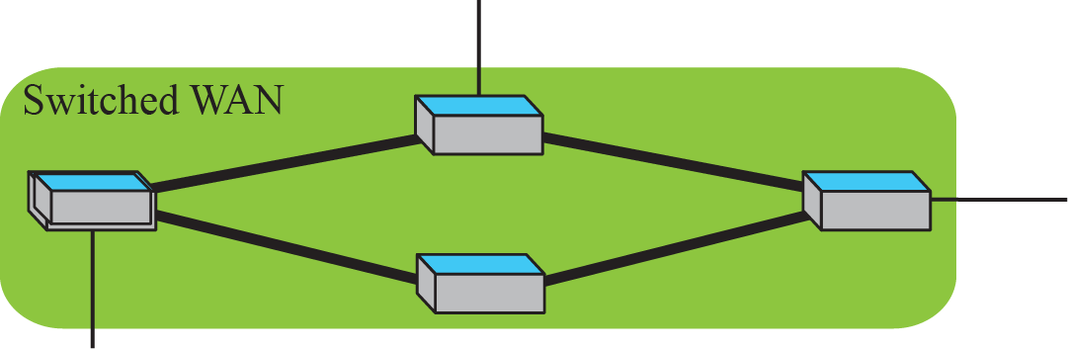
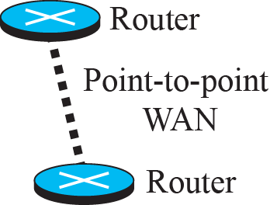
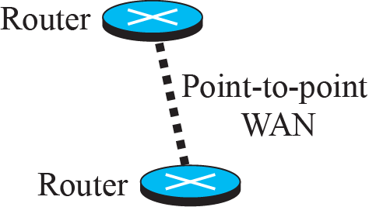
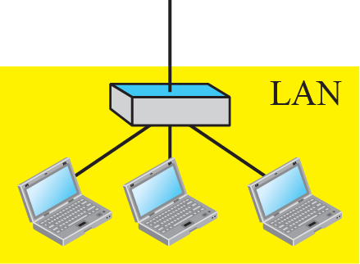
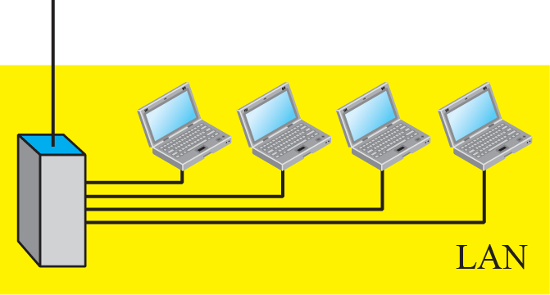
Figure 1.12: A heterogeneous network made of WANs and LANs
1.<number>
Notes:
1.#

Slide 43
1.3.3 Switching
An internet is a switched network in which a switch connects at least two links together. A switch needs to forward data from a network to another network when required. The two most common types of switched networks are circuit-switched and packet-switched networks. We discuss both next.
1.<number>
Notes:
1.#

Slide 44

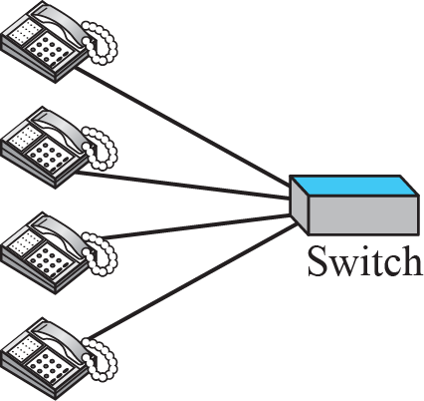
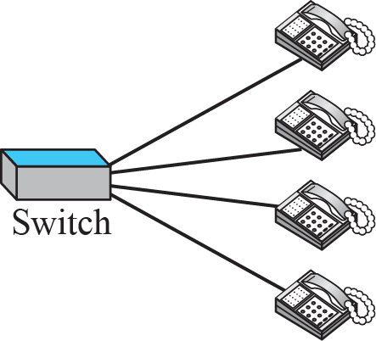
Figure 1.13: A circuit-switched network
1.<number>
Notes:
1.#

Slide 45

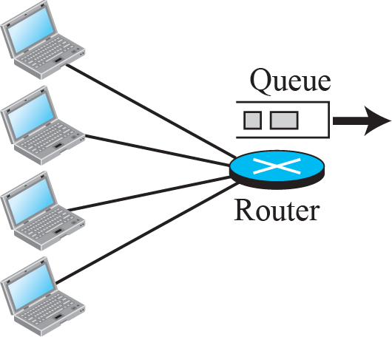
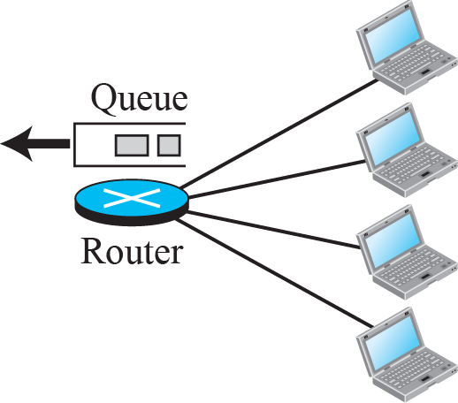
Figure 1.14: A packet-switched network
1.<number>
Notes:
1.#

Slide 46
1.3.4 The Internet
As we discussed before, an internet (note the lowercase i) is two or more networks that can communicate with each other. The most notable internet is called the Internet (uppercase I ), and is composed of thousands of interconnected networks. Figure 1.15 shows a conceptual (not geographical) view of the Internet.
1.<number>
Notes:
1.#

Slide 47
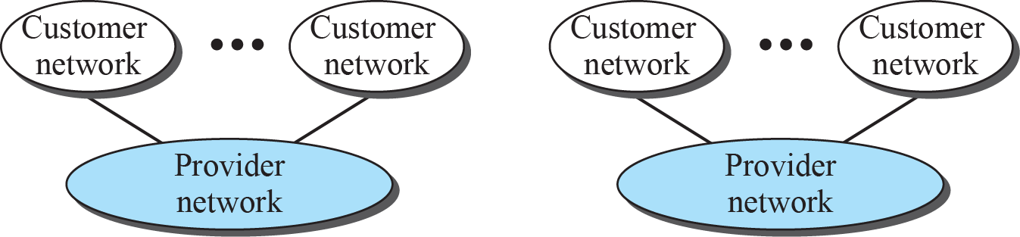
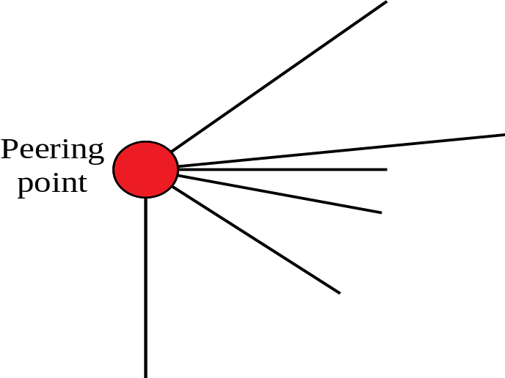

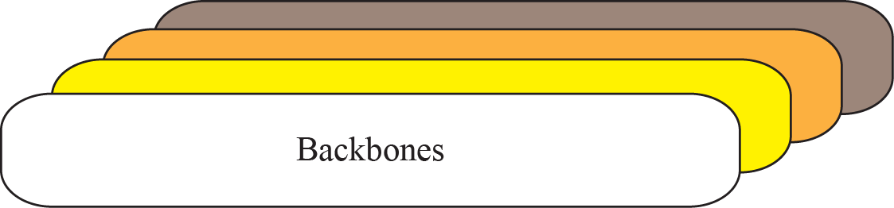
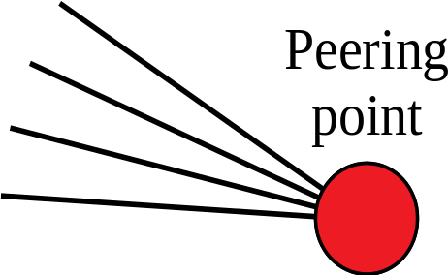

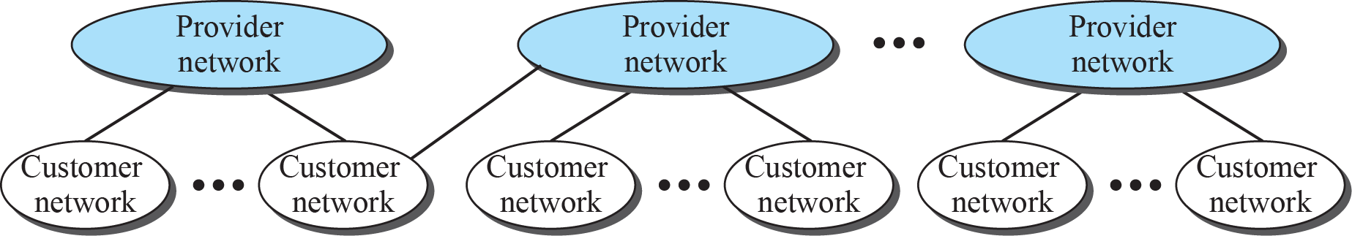
Figure 1.15: The Internet today
1.<number>
Notes:
1.#

Slide 48
1.3.5 Accessing the Internet
The Internet today is an internetwork that allows any user to become part of it. The user, however, needs to be physically connected to an ISP. The physical connection is normally done through a point-to-point WAN.
1.<number>
Notes:
1.#

